Slide 1
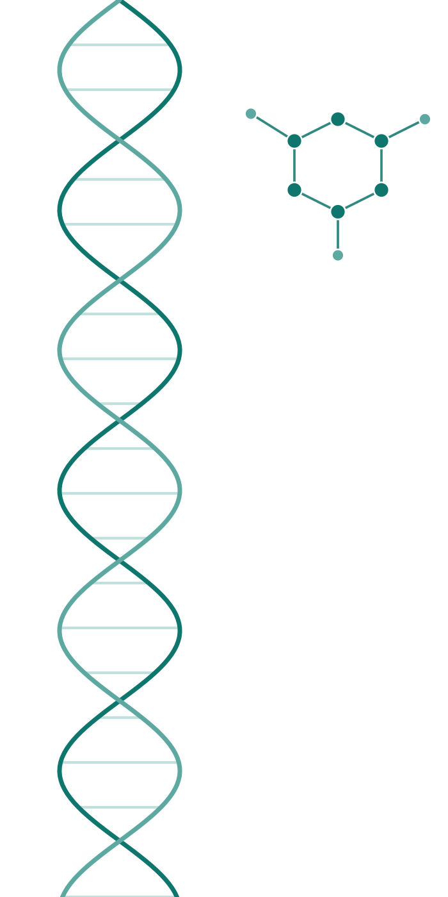

LIVING IN SILICO INC.
AI/ML PORTFOLIO PROJECT
INDUSTRY SPONSOR
THE LEARNING LOOP
We Built an AI That Finds
New Antibiotics
Screening compounds against the SSB–PriA interaction in multidrug-resistant Klebsiella pneumoniae — from a research question to a live, deployed system.
Ruchi Shah (Lead) · Isha Shah · Krutik Babariya · Dilkhush Yadav
AIGC-5005 Capstone, Humber Polytechnic
Notes:
Good [morning/afternoon]. We want to present this project the way we would in a job interview, not a classroom — a hard, messy, real-world data problem turned into a working, deployed product.

Slide 2
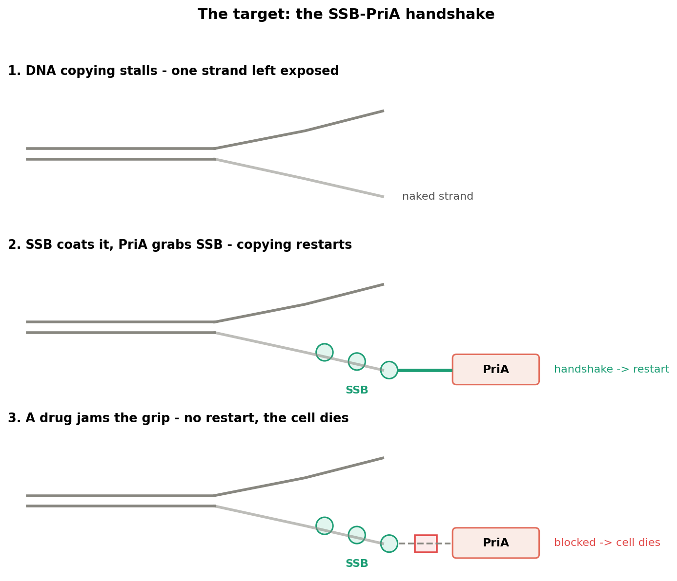
WHY THIS TARGET MATTERS
A Problem Worth Solving, Not Just an Assignment
Humans Don't Have It
Our cells restart DNA replication a completely different way — a drug that jams this handshake is safe for patients.
It Is Conserved
Gram-negative pathogens share this repair machinery, so one drug could work against several dangerous bacteria at once.
Genuinely New Target
441K+ compounds already screened with no computational triage layer built for this target — before this project.
Figure 1 — The SSB–PriA handshake, and what a drug would do to it
§ 2 — 14
Notes:
Klebsiella pneumoniae is a WHO critical-priority pathogen — carbapenem-resistant strains have up to 50% mortality when last-resort antibiotics fail. A genuinely new target buys a whole new class of drug.

Slide 3
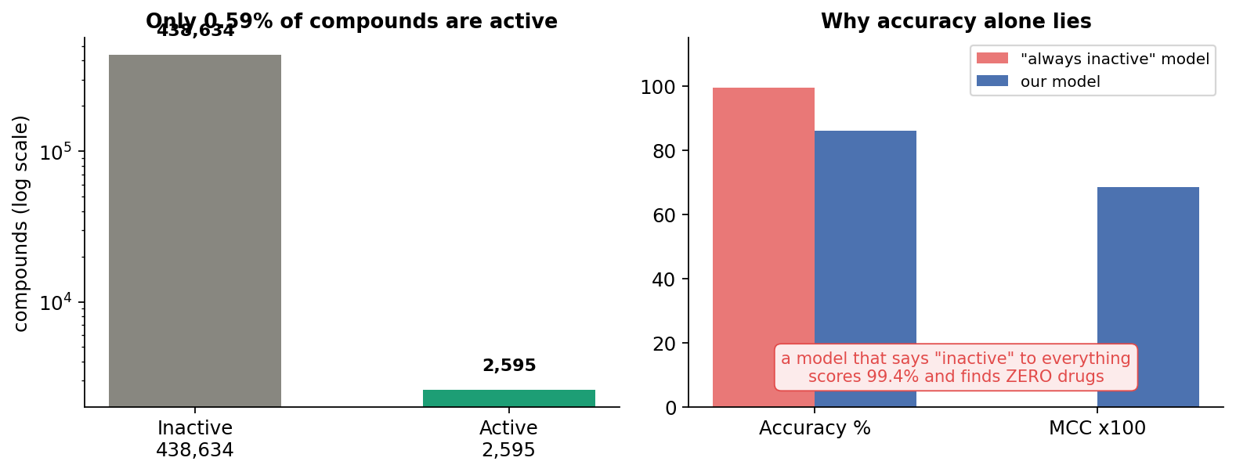
THE PROBLEM WE SOLVED
Find the 1 Molecule in 171 That Actually Works
Our sponsor needed to rank hundreds of thousands of candidate molecules — before spending a dollar on lab testing — for a target with an extreme, real-world 0.59% hit rate.
441,244
compounds physically tested in a real lab assay — not a simulation
0.59%
true active rate. About 6 useful compounds in every 1,000
99.4%
accuracy of a lazy model that says "inactive" every time — and finds zero drugs
Figure 2 — The imbalance, and why accuracy alone is misleading
§ 3 — 14
Notes:
In this dataset, accuracy lies. A model can look 99.4% accurate and be completely useless — so we report ROC-AUC, PR-AUC, recall, and MCC, metrics that cannot be fooled by class imbalance.

Slide 4

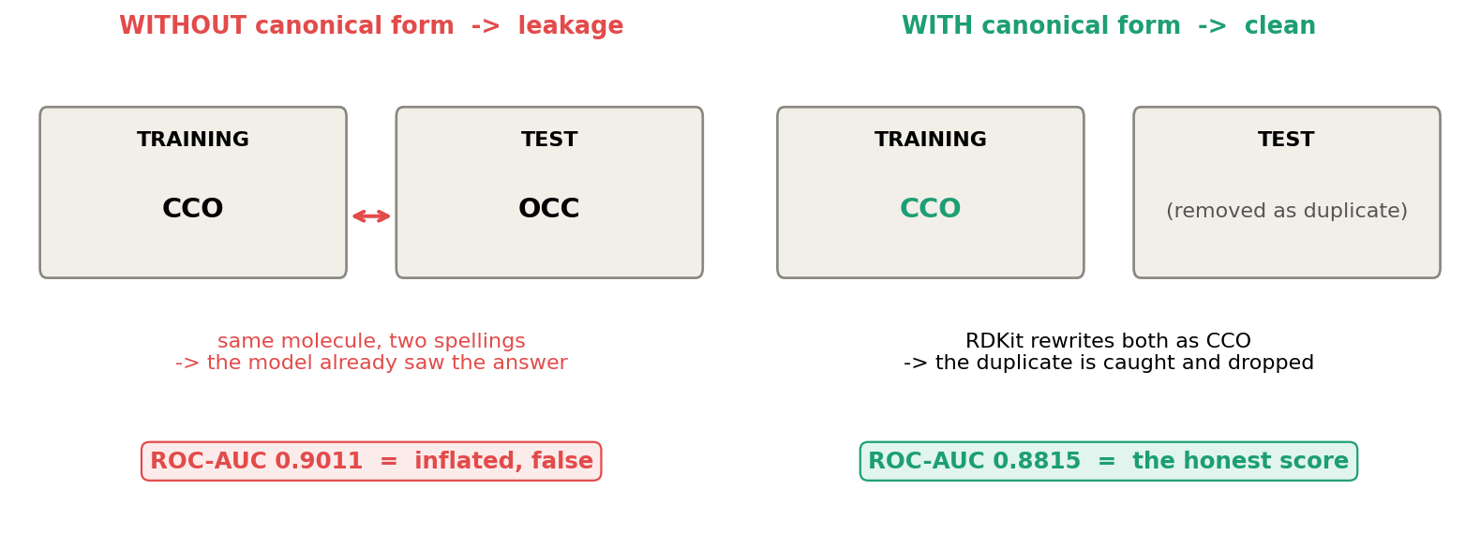
OUR STORY
We Found Our Own Bug — And That's the Point
The same molecule can be written two different ways. If one spelling lands in training and the other in test, the model has already seen the answer — data leakage.
We audited ourselves.
Ran our own data-integrity check and found duplicate molecules leaking between train and test.
We rebuilt it properly.
Canonicalized every molecule, removed 27 duplicates and 13 ambiguous labels — not a patch.
We reported the honest number.
ROC-AUC went down from 0.9011 to 0.8815 — the true score, not the flattering one.
Figure 6 — Data leakage, and how canonical form removes it
§ 4 — 14
Notes:
Most teams would never mention the bug. We think finding and fixing our own mistake, and proving the fix with real evidence, is a stronger story than a suspiciously clean first result.

Slide 5
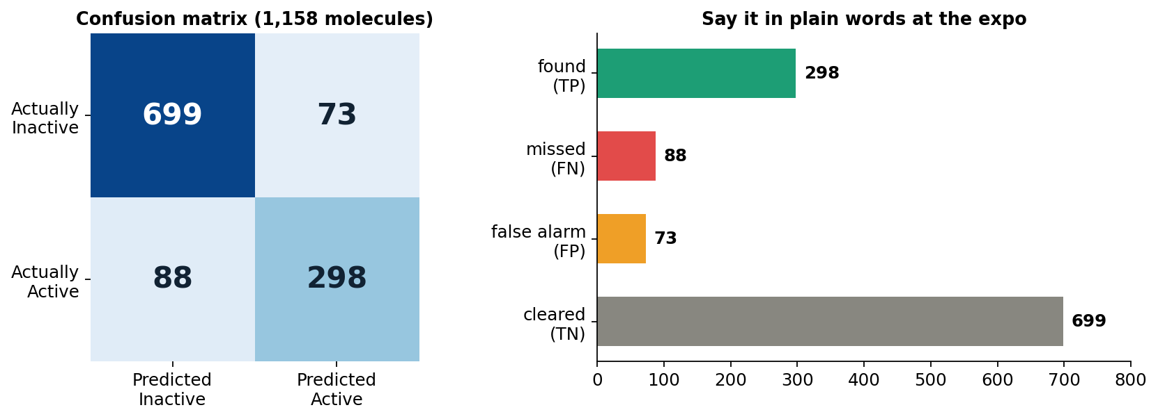
WHAT WE ACHIEVED
Not a Prototype — A Working, Proven System
86.10%
0.8928
0.684
Live
Test accuracy, above sponsor's 85% floor
Ensemble ROC-AUC (3 seeds)
MCC — cannot be fooled by imbalance
Deployed on Azure, real traffic
5-fold cross-validation: ROC-AUC 0.8842 ± 0.0069 — stable, not a lucky split.
Independently reproduced our own final numbers from saved weights.
Screened a real, 15,538-compound commercial library through the live system.
Figure 14 — Confusion matrix and final test metrics, said in plain words
§ 5 — 14
Notes:
These aren't projected numbers — this is a system live right now, independently re-verified, and already used to screen a real fifteen-thousand-compound commercial library.

Slide 6
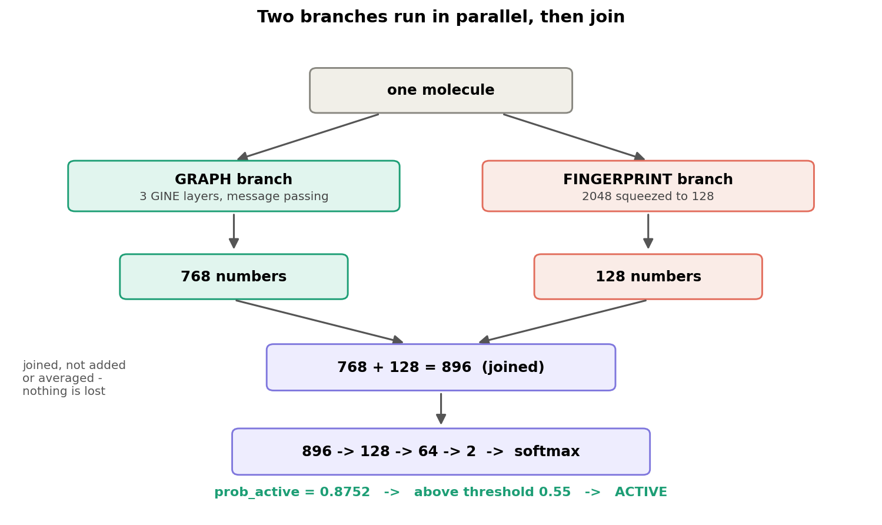
THE TECHNICAL MERITS
The Architecture Decisions We Owned
Why GINE, Not GAT
GAT and GCN average neighbour signals — a model using averaging cannot tell one methyl group from three. GINE sums them. Xu et al. (2019) proved sum-based GIN matches the Weisfeiler–Leman test — the theoretical ceiling for this model family.
The Fingerprint Bottleneck
We squeezed the fingerprint branch from 2048 raw bits to 128 because the full-size version was memorising molecules as a lookup table, not learning chemistry — that cut parameters from 826K to 494K and reduced overfitting.
Figure 9 — The two branches and how they join
§ 6 — 14
Notes:
Two decisions I owned directly: an architecture that actually matches the structure of molecular data, and a fingerprint bottleneck that forces the model to compress instead of memorize.

Slide 7
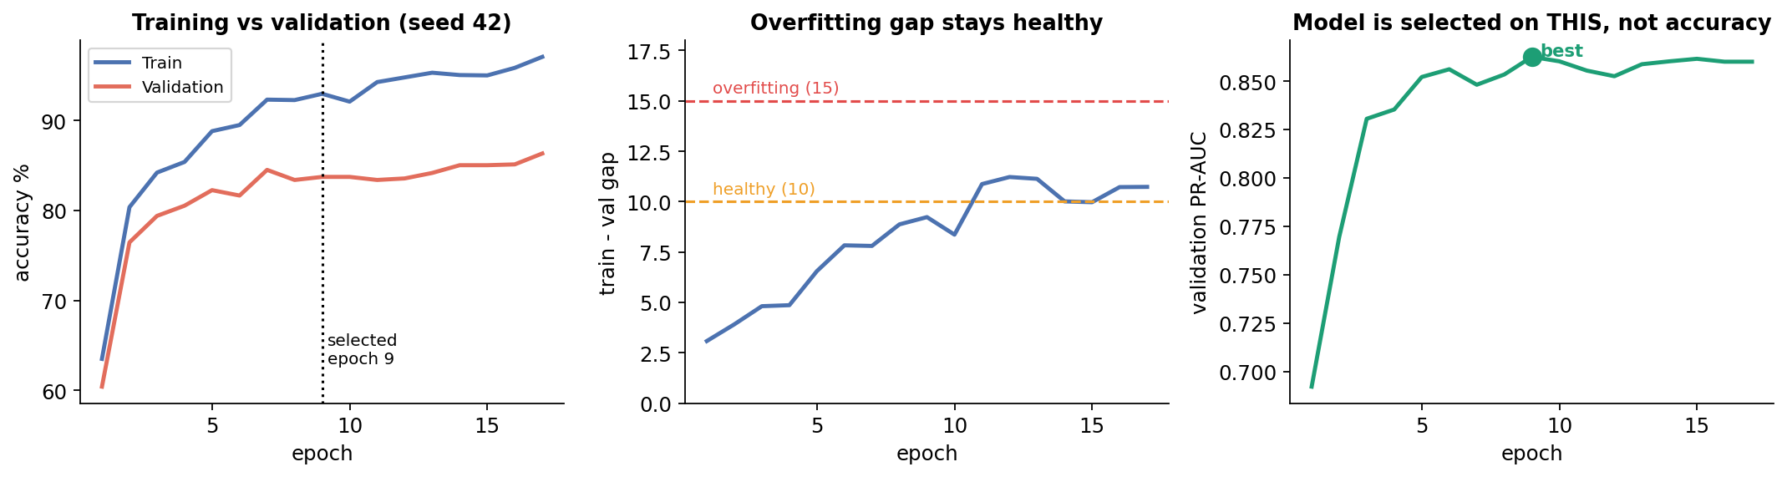
THE TECHNICAL MERITS
Two Original Contributions We Own
Figure 11 — Training curves, and the overfitting gap staying healthy
Dynamic Resampling
Focal Loss — Proven, Not Assumed
Instead of reusing the same 3,594 inactive molecules for 40 epochs, we draw a fresh set every epoch from a pool of 58,250. The overfitting gap fell from 17 points to 7–11, and the model saw 6.7× more unique chemistry.
We ran a controlled four-way comparison on identical data before choosing. Strategy D (dynamic + focal) won on both overfitting gap (7.57) and balanced accuracy (81.67%) — not the single highest headline number.
§ 7 — 14
Notes:
The old approach reused the same inactives for 40 epochs and memorized them. Fresh sampling and a controlled four-way test on focal loss are the two decisions we can defend with numbers, not intuition.

Slide 8
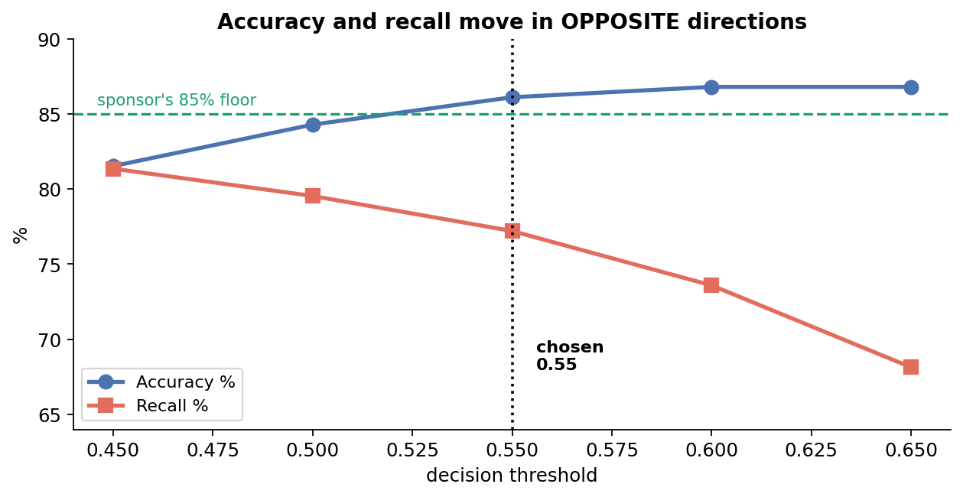
RIGOROUS VALIDATION
Choosing the Threshold, and Proving It's Not Overfitting
Why 0.55?
Sponsor required an 85% accuracy floor. Among thresholds clearing it, 0.55 gave the highest recall — a missed drug is lost forever; a false alarm just costs a little lab time.
Cross-validation is stable
5-fold ROC-AUC: 0.8842 ± 0.0069 across 7,704 pooled predictions. It also showed the sponsor's combined ask (85% accuracy AND 80% recall) isn't reachable at any single threshold — we reported that rather than hiding it.
Figure 13 — Accuracy and recall move in opposite directions
§ 8 — 14
Notes:
As the threshold rises, accuracy goes up and recall goes down — like the sensitivity knob on a metal detector. We selected 0.55 on validation with a safety margin, then scored test exactly once.

Slide 9
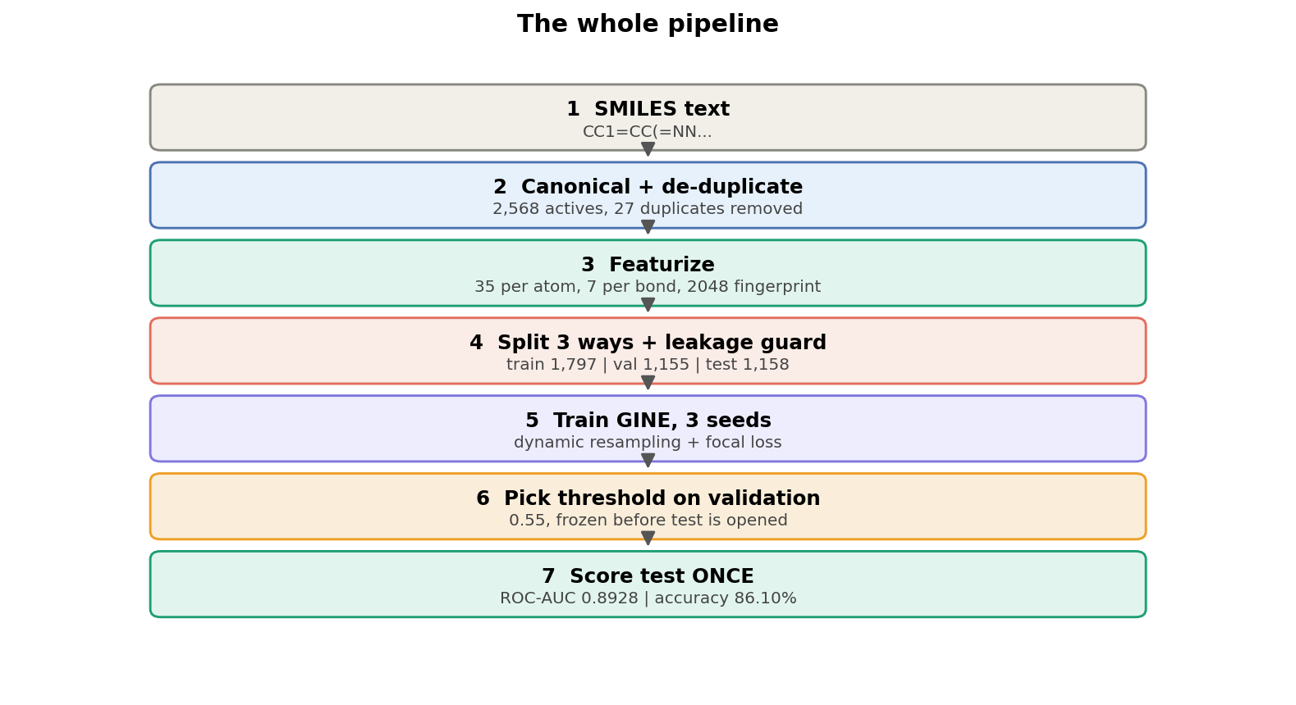
REAL-WORLD PROOF
We Didn't Stop at the Notebook
The model is live. We used it to screen a real commercial compound library — not our own training data — and validated its predictions against published literature values.
15,538
compounds from a real commercial antibacterial library, screened end to end
Verified
predictions cross-checked against independently published activity data
Azure ML
managed online endpoint, CPU instance — a 494K-parameter model doesn't need GPU
gnn-learningloop-docker-...azurewebsites.net
Figure 16 — The complete pipeline, from raw SMILES to live endpoint
§ 10 — 14
Notes:
I built the web app that makes this real, running on Azure infrastructure Krutik set up. We pointed the live system at a real, external, commercial compound library and checked what it said.

Slide 10



WHY IT MATTERS
What This Outcome Actually Buys the Business
Speed
Cost
Trust
Rank a full library in seconds instead of weeks of manual triage before any wet-lab work begins.
Every lab test costs real money — sending only the top-ranked candidates cuts wasted experiments.
Cross-validation and independent reproduction mean the numbers hold up to scrutiny, not just a nice-looking demo.
Without the model, a lab testing at random finds about 6 useful compounds in every 1,000. With the model ranking the list, they test the top candidates instead — and the hit rate rises enormously.
§ 9 — 14
Notes:
It's faster, it's cheaper, and — because of how rigorously we validated it — it's something people can actually trust the output of.

Slide 11
SYSTEM ARCHITECTURE
Built Like Production Software, Not Just a Notebook
Research
Data (CSV)
Clean +
RDKit Parse
Train GINE
(PyTorch)
FastAPI
Backend
Docker →
Azure ACR
Azure App
Service → Browser
Figure — The complete path from raw SMILES to a live prediction, end to end
A Real API, Not a Script
The Full Stack
The trained model loads into memory once at startup; every request reuses it — no reload latency per prediction.
Frontend
HTML, CSS, JavaScript
Backend
FastAPI
Predict a single SMILES string
ML
PyTorch
Graph
Torch Geometric
POST
/predict
Chemistry
RDKit
Container
Docker
POST
/predict-csv
Batch prediction from an uploaded CSV
Registry
Azure Container Registry
Hosting
Azure App Service (Linux)
Server
Gunicorn / Uvicorn
GET
/health
Health endpoint Azure polls to confirm the service is alive
Every prediction is reproducible: the exact model weights, featurizer version, and locked threshold ship inside the Docker image — nothing drifts silently between runs.
GET
/docs
Auto-generated Swagger documentation
§ 11 — 14
Notes:
This isn't a script we ran once. FastAPI loads the model once at startup and serves it behind a real API — health checks, Swagger docs, batch CSV upload — packaged in Docker, pushed to Azure Container Registry, and served by Azure App Service behind HTTPS.

Slide 12


WHERE THIS CAN GO
Bigger Than One Bacterium
The methodology transfers far beyond this one project.
Other Pathogens & Targets
Beyond Antibiotics
Beyond Chemistry Entirely
The same pipeline applies to any protein-protein interaction target, in any drug-resistant organism — not just SSB–PriA in K. pneumoniae.
Antiviral, antifungal, and oncology screening face the exact same challenge: a huge library and a tiny fraction of real hits.
Dynamic resampling, focal loss, and validation-only threshold tuning are general answers to severe class imbalance — fraud detection, rare-disease diagnosis, manufacturing defect detection.
The hard part was never “Klebsiella pneumoniae” specifically — it was building a reliable way to find rare signal in an overwhelming amount of noisy, imbalanced data. That skill generalizes.
§ 12 — 14
Notes:
The reason this project matters isn't that we solved one narrow chemistry problem. The infrastructure we built doesn't care what target it's screening for — the same pipeline could run against a different pathogen tomorrow.

Slide 13
OUR VISION & THE TAKEAWAY
What We'd Build Next — and What This Says About How We Work
What We'd Build Next
A multi-target platform
Stricter, prospective validation
More confirmed active data
Publication
Screen against multiple resistant pathogens from a single unified system.
Scaffold-based splitting to test generalization to genuinely novel chemistry.
With only 2,568 actives, this is the biggest lever left to pull.
Submitting this work for academic publication with our sponsor.
What This Project Says About How We Work
We audit our own work
We validate rigorously
We ship, not just prototype
We work as a team
We found and fixed a real bug before anyone else could — and reported the honest, lower number openly.
Cross-validation and independent reproduction, not one lucky metric — and we say what we don't know.
A real API, containerized and deployed on Azure — not a notebook that only runs once.
Four people, one accountable pipeline — from data audit to deployment to this room.
§ 13 — 14
Notes:
Here's what's next: a multi-pathogen platform, stricter prospective validation, growing the active-compound dataset, and publishing this work. And if you take one thing from this talk: we audit ourselves, we validate rigorously, we ship real systems, and we did it together.

Slide 14
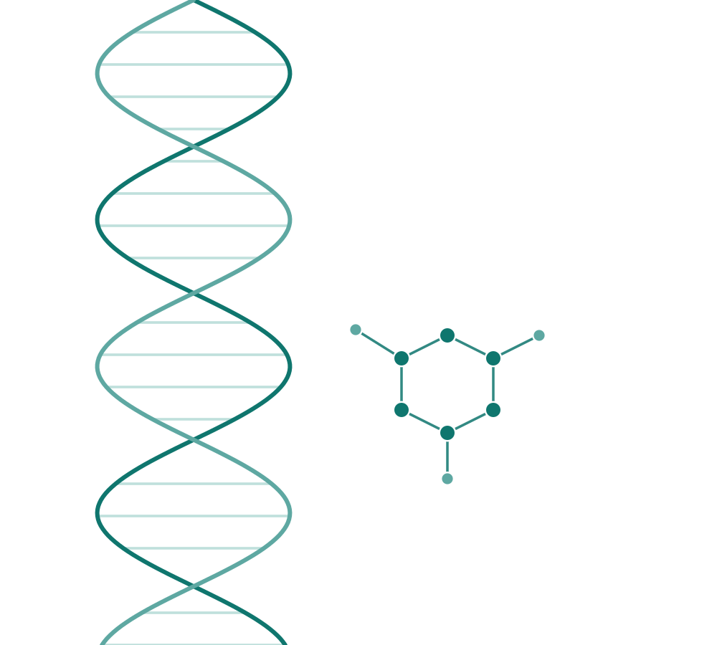
Thank You
Happy to walk through the code, the data, or the live system.
Ruchi Shah · Isha Shah · Krutik Babariya · Dilkhush Yadav
Industry Sponsor: Living In Silico Inc. · Supervisors: Prof. Timothy Wong
AIGC-5005 Capstone Project · Faculty of Applied Sciences & Technology, Humber Polytechnic
Notes:
Thank you. We're glad to go deeper into any part of this — the architecture, the validation, the deployment, or the code itself.

